Slide 1



High Speed Backdoor Injection via Bootable USB

Slide 2
About Us
Piotr Marszalik
Manager & IS Consultant, Crowe Horwath LLP
Pentester, Red Teamer
OSCE, OSCP, CISSP
Twitter: @addenial
Michael Wrzesniak
IS Consultant, Crowe Horwath LLP
Pentester, Red Teamer, Malware Dev

Slide 3
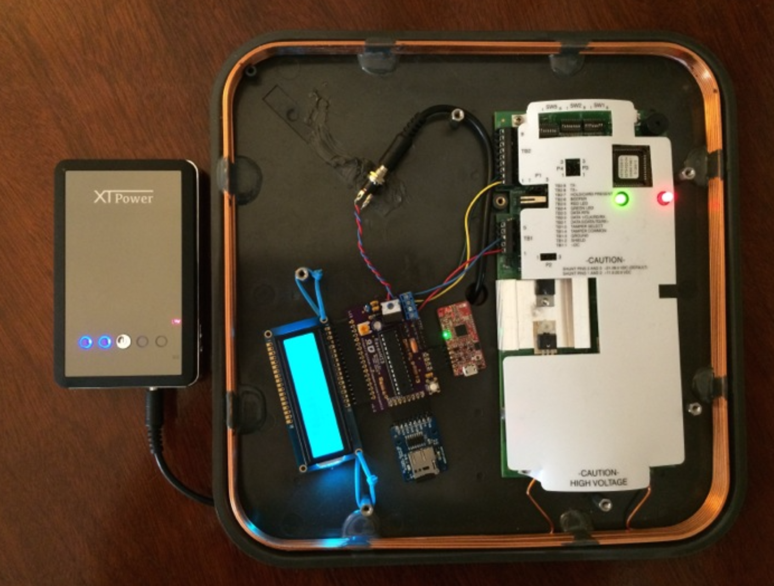
Physical Security Awareness
Obtaining physical access is not difficult..
Just walk in..
Impersonate employees or contractors
Tailgate
Social-engineering
RFID spoofing / cloning
Long Range Proximity Reader Mod
https://github.com/CroweCybersecurity/ravenhid

Slide 4
You’re in.. now what.
Persistent internal network access via a deployable device
Live unused network ports?
Transparent bridge for 802.1x NAC?
Transparent bridge for PoE devices?
Find unattended / unlocked workstations
Collect local password hashes from unencrypted system HDDs
Linux bootable USB drive

Slide 5

Inefficient Offline Hash Collection
Traditional approach:
Manual with USB bootable Kali
AKA struggle bus..
Issues:
Slow boot...
Unnecessary libraries
Persistent storage
Potential for data loss
Improperly unplugged USB devices
No device encryption

Slide 6

SmuggleBus v1
Built on Tiny Core Linux
Only essential packages are being loaded
No networking
Upon boot, modified HashGrab python script configured to:
Find and mount OS partition
Find SAM, SYSTEM, and SECURITY files
Using a combination of symmetric and asymmetric cryptography, files get encrypted prior being saved
Once written, drive is safely unmounted and system is poweroff
Requires no keyboard interaction from the user
Tinycore Site: http://distro.ibiblio.org/tinycorelinux/

Slide 7
SmuggleBus v1 – encryption
SETUP
Generate RSA public/private key pair
Copy the public key onto the SmuggleBus home directory

Slide 8
SmuggleBus v1 – encryption
EXECUTION WORKFLOW
SmuggleBus generates a random key (symmetric-key)
The symmetric-key is used to AES 256 encrypt the collected registry hives
Public key is used to encrypt the symmetric-key
Once ran, new folder will be created in home directory, containing:
SAM.enc
SYSTEM.enc
SECURITY.enc
KEY.enc

Slide 9
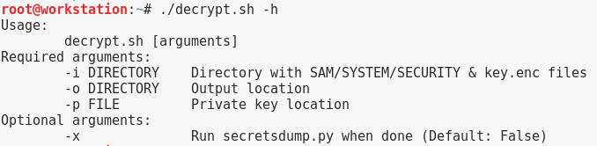
SmuggleBus v1 – encryption
TO DECRYPT
Private key is used to decrypt the symmetric-key
Decrypted symmetric-key is used to decrypt the registry hives

Slide 10
V1 Demo

Slide 11

Hashes are cool, but if we could also implant a backdoor for remote access…

Slide 12
SmuggleBus v2
Backdoor implant requirements:
Minimal impact to the target system
Clean-up is important, no glaring IOCs
Need to run in SYSTEM context
Code needs to be executed on boot prior to user-level authentication
Our Access:
Access to disk
Access to registry
Delivery mechanism considerations:
Registry Start Keys
Scheduled Tasks
Services

Slide 13
Registry Start Keys
Reged
Can inject keys into the registry
Part of Chntpw (also known as Offline NT Password & Registry Editor)
Order:
HKEY_LOCAL_MACHINE\Software\Microsoft\Windows\CurrentVersion\RunServicesOnce
HKEY_LOCAL_MACHINE\Software\Microsoft\Windows\CurrentVersion\RunServices
<Logon Prompt>
HKEY_LOCAL_MACHINE\Software\Microsoft\Windows\CurrentVersion\RunOnce
HKEY_LOCAL_MACHINE\Software\Microsoft\Windows\CurrentVersion\Run
HKEY_CURRENT_USER\Software\Microsoft\Windows\CurrentVersion\Run
StartUp Folder
HKEY_CURRENT_USER\Software\Microsoft\Windows\CurrentVersion\RunOnce
Analysis:
Execution needs to occur before logon prompt
Unsuccessful when tested RunServices key on Win7 OS

Slide 14


Windows Scheduled Tasks Analysis
New “Test Task” Created
System changes:
Three new registry keys
HKLM\SOFTWARE\Microsoft\Windows NT\CurrentVersion
\Schedule\TaskCache\Tree\Test Task
HKLM\SOFTWARE\Microsoft\Windows NT\CurrentVersion
\Schedule\TaskCache\Tasks\{B515B725-D53D-411F-9DF6-500895D96EDF}
HKLM\SOFTWARE\Microsoft\Windows NT\CurrentVersion
\Schedule\TaskCache\Boot\{B515B725-D53D-411F-9DF6-500895D96EDF}
New File
C:\Windows\System32\Tasks\Test Task

Slide 15
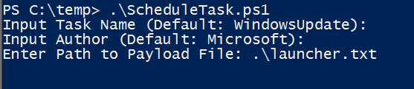
Preparing Scheduled Task Backdoor
Attacker’s development Windows system:
New Scheduled Task is created (payload)
Configured for NT AUTHORITY\SYSTEM privilege
Trigger set for “At startup” with a short delay on execution
PowerShell one-liner download cradle set as the task action
2nd task is created (clean-up)
Longer delay
Clean-up the payload task and itself
Associated registry keys and files are exported and copied onto the SmuggleBus
Placed in the home directory “shell_files” folder
Automated with ScheduleTask.ps1

Slide 16
Porting to Windows 10
Hibernation file
Needs to be removed for read/write access to disk
If exists, unable to update registry from offline system
Scheduled Task updates?
Additional hashing performed?

Slide 17
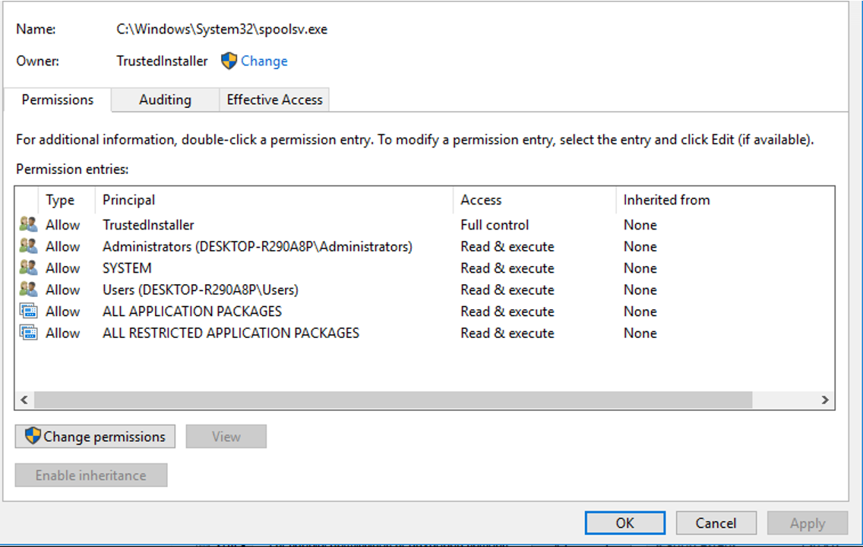
Service Backdoor
SmuggleBus Execution Flow:
Backdoor is injected
Offline disk, rename spoolsv.exe > spoolsv.exe.bak
Upload hacked spoolsv.exe
System reboots, hacked spoolsv.exe executes
Configured to execute a web hosted PowerShell one-liner
New Scheduled Task is created (payload)
SYSTEM shell
2nd task is created (clean-up)
Cleans up the scheduled tasks
Deletes hacked spoolsv.exe and restores original exe
Fixes temporarily modified service permissions
Service is started, resumes normal operation

Slide 18
PoC || GTFO

Slide 19
Recommendations
Encrypt the Planet
Advanced Threat Protection
Application whitelisting
Device Guard
PowerShell v5 and logging

Slide 20

Future Dev
More robust task scheduling script
Setting custom time limits, custom commands, etc.
OS independent
Ability to generate payloads for Win7 from Win10 and vice versa
Additional payload execution techniques
Additional Win10 research
Alternative backdoor options
Sticky keys for cmd.exe, etc.

Slide 21





Thank You.
CONTACT
Piotr Marszalik
=> peter.mars[at]outlook[dot]com
=> twitter.com/addenial
=> github.com/addenial
Michael Wrzesniak
=> mwrzesniak[at]gmail[dot]com
=> github.com/0x1ced
PROJECT PAGE
=> github.com/CroweCybersecurity/smugglebus

